Slide 1
STUDENT TO DO LIST APPLICATION
SAMYUKTHA S (221801043)
VAISHNAVI M (221801058)

Slide 2
INTRODUCTION
Student Pop is a dynamic reminder and task management app tailored specifically for students. Designed to streamline academic and personal organization, Student Pop combines a user-friendly to-do list, smart task scheduling, and customizable reminders into a single platform. With features like integrated calendar views and task prioritization, Student Pop helps students manage their assignments, deadlines, and study sessions efficiently, ultimately reducing stress and enhancing productivity. Whether balancing coursework, extracurricular activities, or personal commitments, Student Pop is your go-to tool for staying organized and on top of your academic life.

Slide 3
EXISTING SYSTEMS
TODOIST
MICROSOFT TO DO
GOOGLE KEEP
TRELLO
Student Pop can draw inspiration from these existing systems while offering tailored features for students, such as academic tracking and specialized scheduling tools. By incorporating unique elements and focusing specifically on student needs, Student Pop can carve out a niche in the crowded task management market.

Slide 4
ADVANTAGES AND DISADVANTAGES
Advantages Disadvantages
Limited Complexity 1.Practical Experience
Project Simplicity 2. Reminder Functionality
Customizable and Extensible 3.Scalability issues
User Benefit 4.Security concerns
Flexibility 5.Cross-Browser compatibility

Slide 5
PROPOSED SYSTEM
Task Management: Add, edit, and delete tasks. Set due dates and priorities.
Task Scheduling: Configure pop-up reminders for deadlines.
Task Organization:
categories and tags.
Sort and filter tasks.
User Interface:
Dashboard with task list and calendar view.

Slide 6
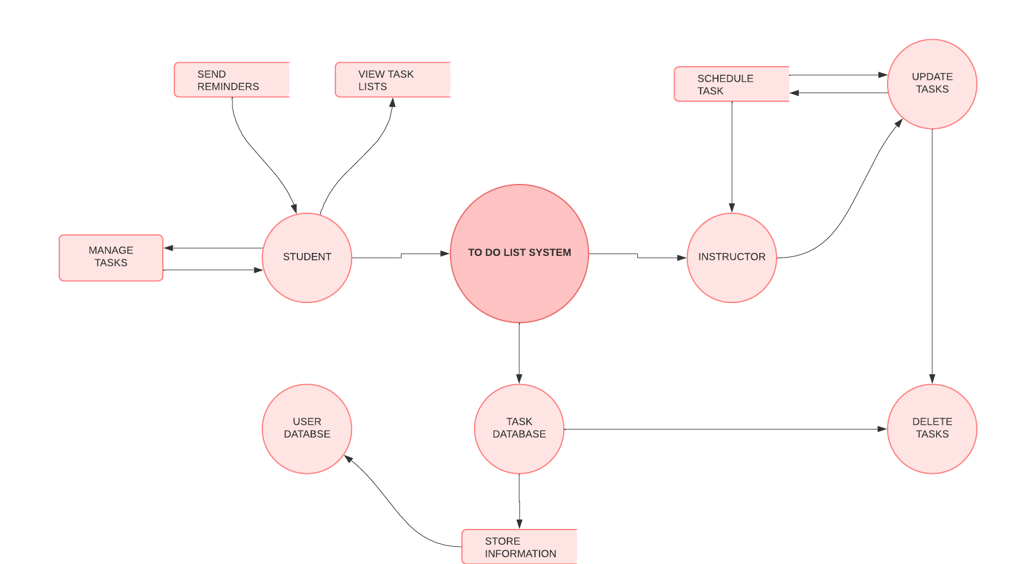
DATA FLOW DIAGRAM

Slide 7
MODULES
Task Management Module
Calendar and Deadlines Module
Progress Tracking Module
Notes and Study Materials Module
Notifications and Alerts Module
atures
Features:
Create notes and categorize by subject or topic.
Attach files, links, and images to tasks or notes.
Search and filter notes by keywords or tags.
Sync notes with tasks for easy access.
their tasks, stay organized, and keep track of deadlines, making the student Create notes and categorize by subject or topic.
Attach files, links, and images to tasks or notes.
Search and filter notes by keywords or tags.
Sync notes with tasks for easy access.
their tasks, stay organized, and keep track of deadlines, making the student

Slide 8
Task Management
Purpose: To create, organize, and track tasks and assignments.
Features:
Add, edit, and delete tasks.
Set due dates, priorities, and reminders.
Categorize tasks (e.g., homework, projects, exams).
Mark tasks as completed or pending.

Slide 9
Calendar and Deadlines
Purpose: To visually track and manage deadlines.
Features:
Calendar view to see upcoming tasks and due dates.
Color-coded tasks based on priority and deadlines.
Set task reminders with notifications.
Sync tasks with external calendars (e.g., Google Calendar).
Purpose: To visually track and manage deadlines.
Features:
Calendar view to see upcoming tasks and due dates.
Color-coded tasks based on priority and deadlines.
Set task reminders with notifications.
Sync tasks with external calendars (e.g., Google Calendar).

Slide 10
Progress Tracking
Purpose: To monitor task completion and academic progress.
Features:
Track completed, pending, and overdue tasks.
Weekly or monthly reports of progress.
Visual charts or graphs showing completion rates and time spent.

Slide 11
Notes and Study Materials
Purpose: To store and organize study notes and resources.
Features:
Create notes and categorize by subject or topic.
Attach files, links, and images to tasks or notes.
Search and filter notes by keywords or tags.
Sync notes with tasks for easy access

Slide 12
Notifications and Alerts
Purpose: To remind students of deadlines, tasks, and updates.
Features:
Push notifications for task deadlines and reminders.
Customizable alert settings (e.g., 1 hour before the task).
Email notifications for task updates or changes.

Slide 13
Agile Model
In the planning phase, the development team outlines the application's goals and creates a product backlog—a prioritized list of features. For a student to-do list app, the backlog might include adding, editing, and deleting tasks, setting reminders, categorizing tasks, and syncing data across devices.
Development proceeds through sprints (short iterations, typically 1–4 weeks). In the first sprint, developers focus on core functionality, such as creating a basic task management system. Subsequent sprints add features like deadlines, notifications, and task categories, with continuous testing and improvements after each sprint.
User feedback plays a central role in Agile. Students testing early versions of the app can provide insights on usability, desired features, and potential issues. This feedback helps prioritize future sprints, ensuring the app evolves to meet real-world needs effectively.
After every sprint, the team conducts a retrospective to evaluate what went well, what challenges arose, and how the process can improve. This fosters continuous improvement in both the product and the development workflow.
By using Agile, the student to-do list app is built incrementally, reducing risks and ensuring a high-quality, user-focused product. Early delivery of a functional version allows students to benefit immediately, with additional features introduced over time.

Slide 14
Unit Testing
Objective: Unit testing ensures that individual parts of the application work as expected, helps catch bugs early, improves code quality, and supports regression testing.
Tools: Popular unit testing tools include pytest, unittest (Python), JUnit (Java), Mocha (JavaScript), RSpec (Ruby), and more.
Example: To write unit tests in Python using the pytest framework, testing methods like task creation, task completion, and overdue checking for a task class.

Slide 15
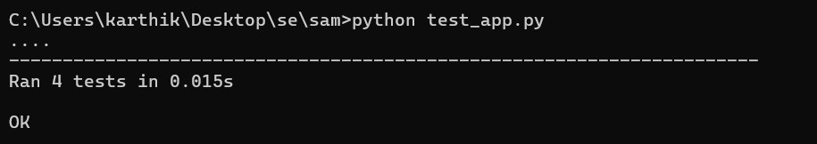
Testing Output

Slide 16
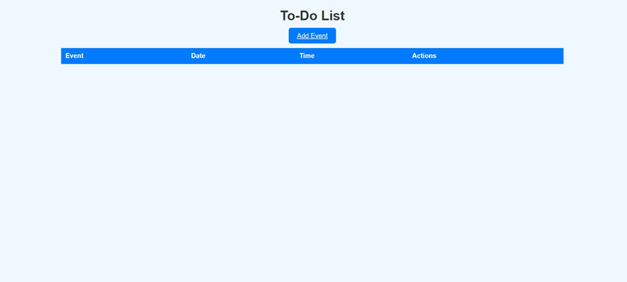
OUTPUT

Slide 17
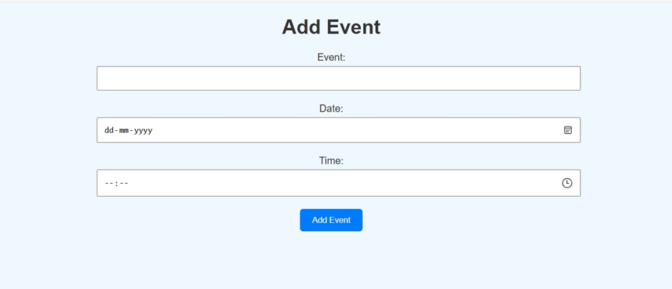

Slide 18
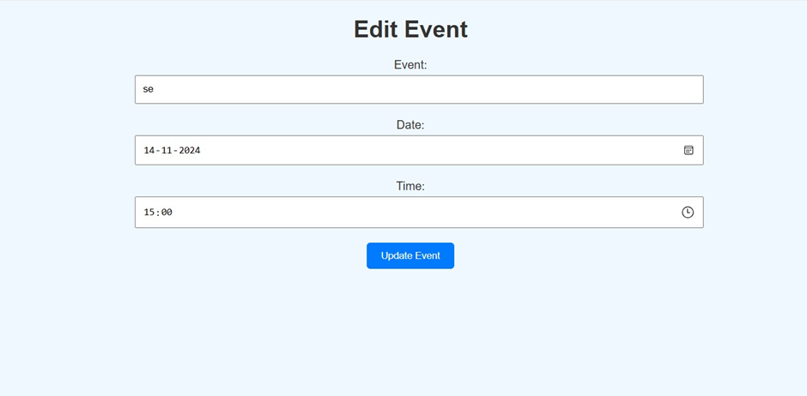

Slide 19
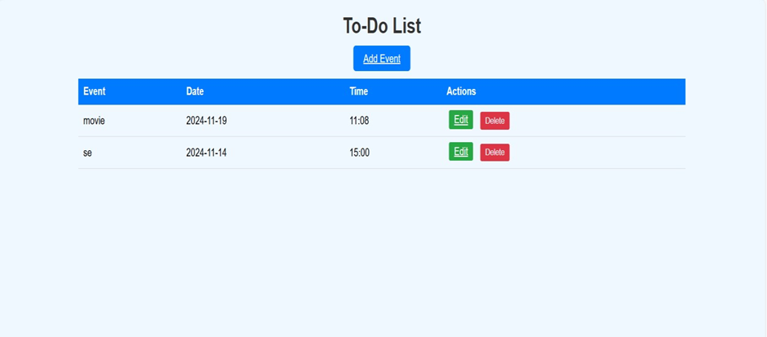

Slide 20
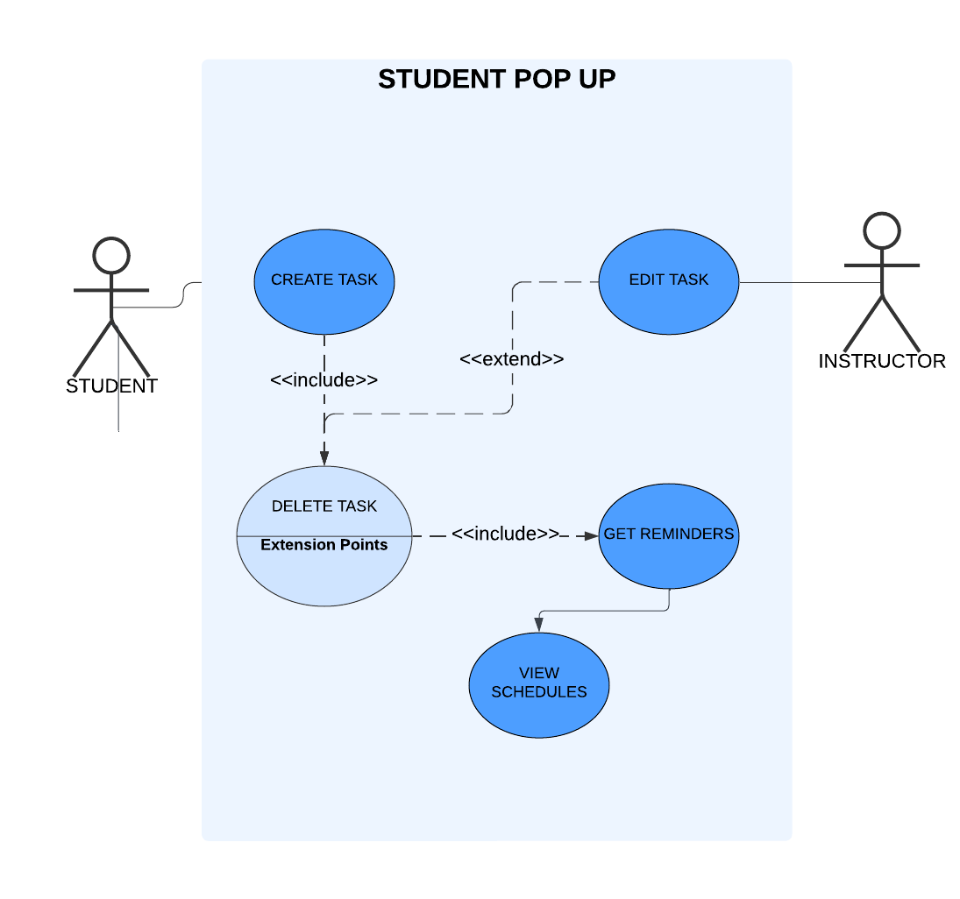
USE CASE DIAGRAM

Slide 21
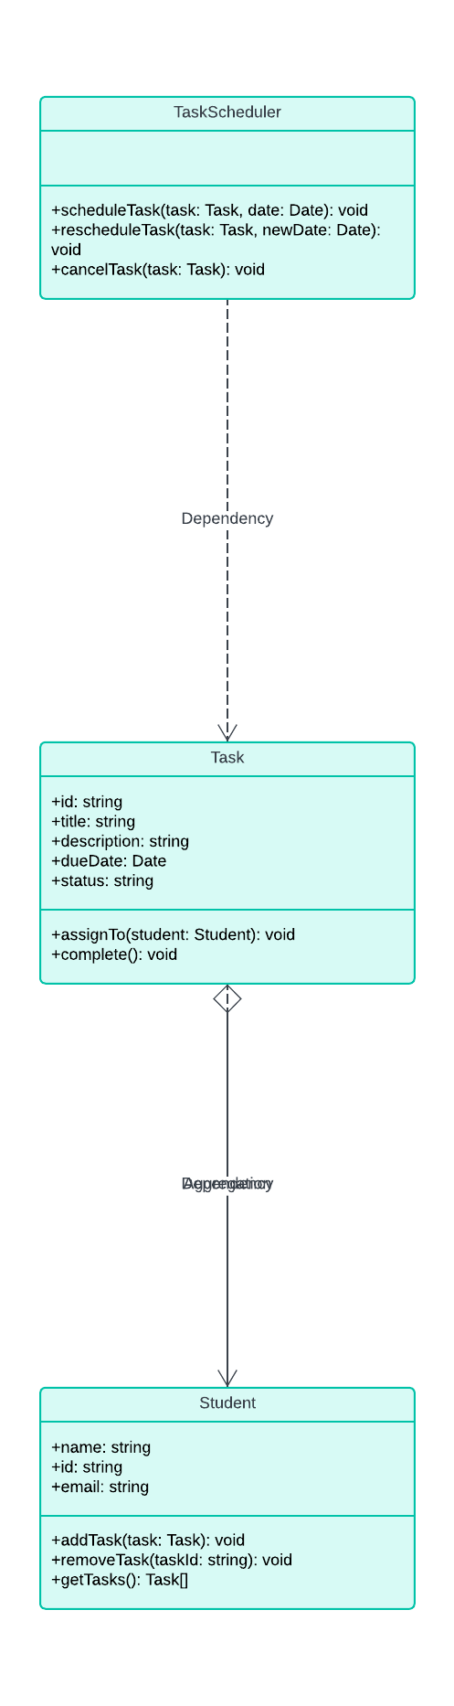
CLASS DIAGRAM

Slide 22
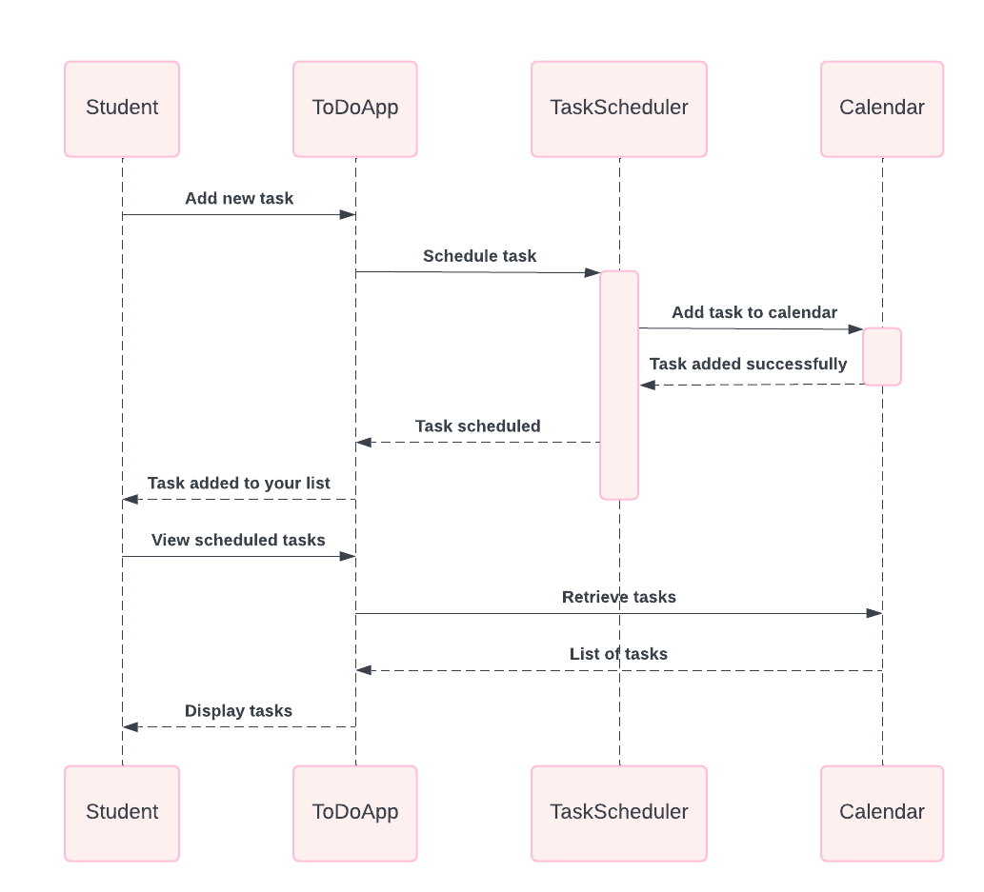
SEQUENCE DIAGRAM

Slide 23
Conclusion
A Student To-Do List application is an essential tool for helping students stay organized and manage their tasks efficiently. By providing features like task creation, due date tracking, and priority management, the application simplifies task management for students. With the integration of task completion tracking and reminders, it ensures that no deadlines are missed. Additionally, unit testing plays a critical role in ensuring the app’s functionality and reliability by identifying bugs early in development. Through effective use of frameworks like pytest, the application can be tested for correctness. This results in an application that is easy to maintain, scalable, and user-friendly. Ultimately, it supports students in achieving better time management and academic success.

Slide 24
REFERENCES
Agile Manifesto – A guide to implementing Agile methodology for iterative and flexible development.
Material Design Guidelines – Best practices for designing intuitive and visually appealing user interfaces.
GitHub - To-Do List App Repositories – Explore open-source to-do list projects for implementation ideas and code examples.

